Slide 1
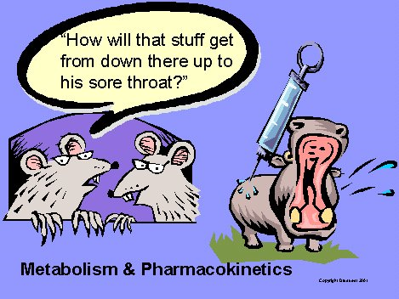
Pharmacokinetics
Chapter 4

Slide 2
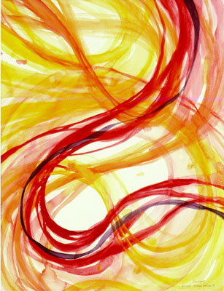
Drug Movement
Pharmacokinetics is the physiological movement of drugs.
Four steps:
  Absorption
  Distribution
  Biotransformation
  (metabolism)
  Excretion

Slide 3
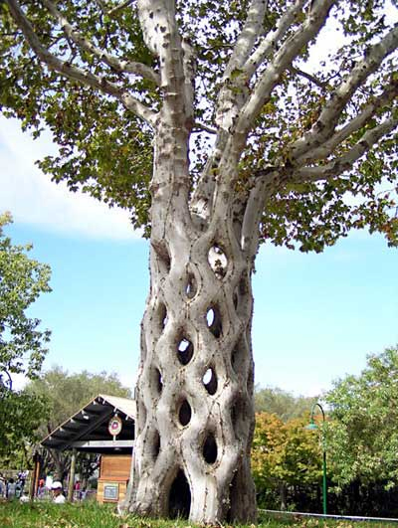
Drug Movement
Pharmacokinetics includes the movement of substances across cell membranes.
Basic mechanisms:
  Passive diffusion
  Facilitated diffusion
  Active transport
  Pinocytosis/phagocytosis

Slide 4
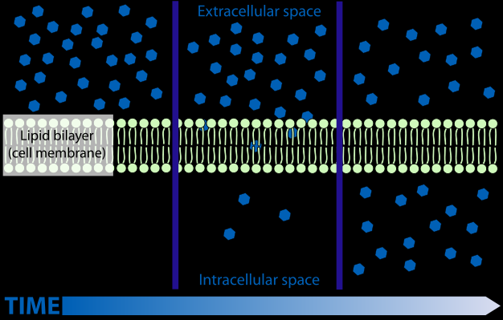
Passive Diffusion
movement of particles from an area of high concentration to an area of low concentration
  Good for small, lipophilic, nonionic particles
  The drug must dissolve and pass through in the cell membrane

Slide 5
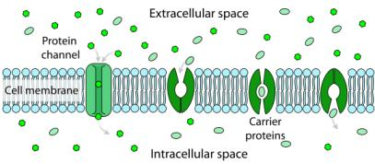
Facilitated Diffusion
passive diffusion that uses a special carrier molecule
  Good for bigger molecules that are not lipid soluble
  No energy is needed for a facilitated diffusion

Slide 6
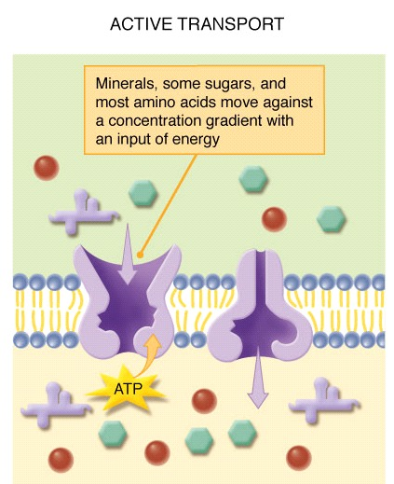
Active Transport
molecules move against the concentration gradient from areas of low concentration of molecules to areas of high concentration of molecules; involves both a carrier molecule
and energy
  Good for accumulation of drugs within a part of
  the body

Slide 7
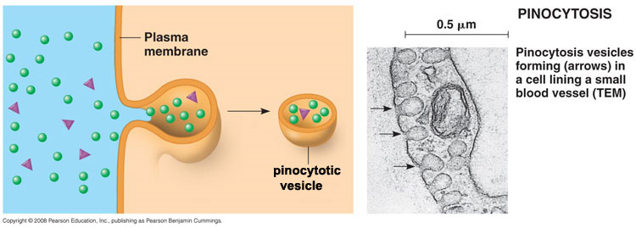
Pinocytosis/Phagocytosis
molecules are physically taken in or engulfed. Pinocytosis is engulfing liquid; phagocytosis is engulfing solid particles
  Good for bigger molecules or liquids

Slide 8
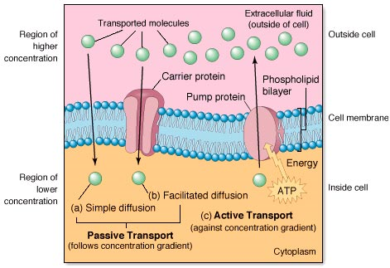
Mechanisms of Drug Movement

Slide 9

Part I: GETTING IN

Slide 10
Drug Absorption
Drug absorption is the movement of a drug from the site of administration into the fluids of the body that will carry it to its site(s) of action
Drug factors include drug solubility, pH, and molecular size
Patient factors include the animal’s age, health, metabolic rate, genetic factors, sex, and species

Slide 11
Species
solubility
age
pH
Health status
Molecular size

Slide 12
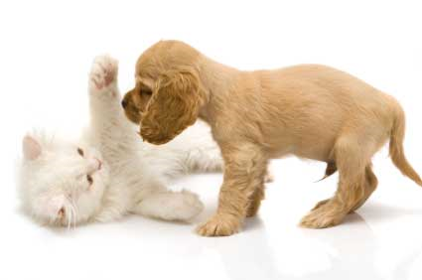
Drug Absorption
Age
  Young animals may not have well developed gastrointestinal tracts and less active enzyme systems
Health
  Sickness will affect the rate of absorption of certain drugs

Slide 13
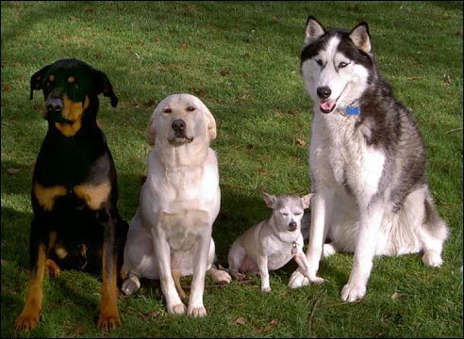
Drug Absorption
Metabolic rate
  Animals with a high metabolic rate may eliminate drugs from their system quicker
Genetic factors
  Individual variation in response to drugs may occur because of genetic differences between animals

Slide 14
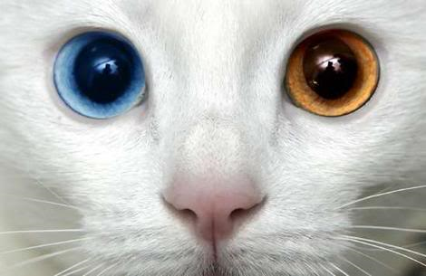
Drug Absorption
Sex
  Male and females have different body compositions
  These specific compositions may affect the action and distribution of the drug
Species
  Cats have a reduced ability to biotransform certain drugs and thus eliminate certain drugs slowly.

Slide 15

Bioavailability
Bioavailability: percent of drug administered that actually enters the systemic circulation
  Intravenous and intra-arterial are 100% bioavailable and have a bioavailability of 1.
  Drugs that are only partially absorbed have a bioavailability of less than 1.
The LOWER the bioavailability, the LESS drug there is in circulation and in the tissue.
Affected by: blood supply to the area, surface area of absorption, mechanism of drug absorption, and dosage form of the drug.
  IM has a higher availability than SC because it has a greater blood supply
  IV and IM have higher availability than oral

Slide 16
pH and Ionization
pH – the measurement of the acidity or alkalinity of a substance
  Lower numbers = acid/acidic; Higher numbers = alkaline/basic
  Neutral = 7
Ionization: the property of being charged
Drugs are both ionized (charged) and nonionized (uncharged)
Hydrophilic drugs are ionized
Lipophilic drugs are nonionized
Nature of the drug: pH of drug
  Weakly acid drugs = hydrophilic form in alkaline environment
  Weakly alkaline drugs = hydrophilic form in acid environment
Drug form is important; oral drugs must have different properties than parenteral drugs

Slide 17
ION TRAPPING
Definition – when a drug changes from an ionized to non-ionized form as it moves along in the body.
Drugs can also enter into different body compartments that have different pH, but it may change its ionization and get trapped in the new compartment.
  Example: Aspirin is MOSTLY non-ionized in the stomach which is readily absorbed in the phospholipid portion of the stomach. Aspirin molecules enter the cells in the stomach where the pH is almost neutral, but shifts to more alkaline, so the aspirin shifts to a MOSTLY ionized form. The drug molecules then get trapped within the stomach cells. Some non-ionized molecules pass into the blood, out of the stomach’s cells where they are converted into an ionized form. This helps to keep them in the blood stream and distribute them to the rest of the body.
This process allows drugs to be excreted from the body.

Slide 18
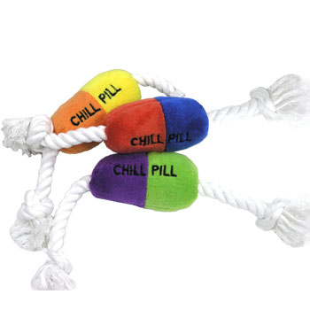
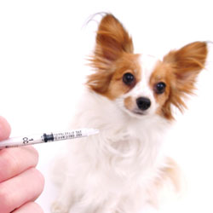
ORAL vs. PARENTERAL
ORALLY ADMINISTERED DRUGS
  Must dissolve before they are absorbed
    This may be sped up by administering fluids with solid drugs
      Speed may be hindered by decreased gastric motility, large drug size, and they must be lipophilic in form
PARENTERAL DRUGS
  Tissue blood flow affects drug absorption
    Also, drugs must by hydrophilic

Slide 19
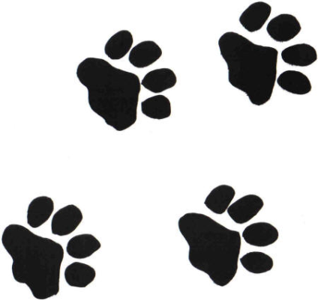
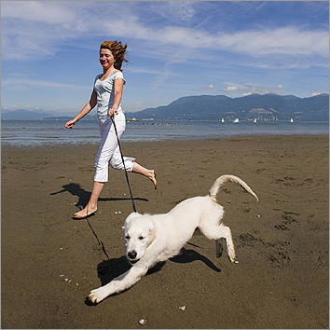
Part II: Moving Around

Slide 20
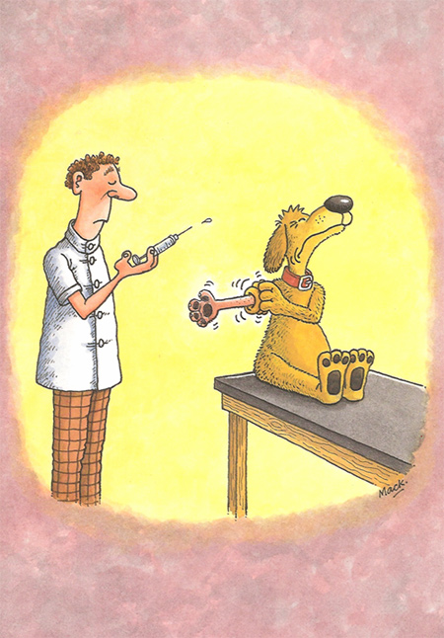
Drug Distribution
Drug distribution is the physiological movement of drugs from the systemic circulation to the tissues
Goal of distribution is for the drug to reach the target tissue or intended site of action
Factors affecting drug distribution:
  Membrane permeability
  Tissue perfusion
  Protein binding
  Volume of distribution

Slide 21
MEMBRANE PERMEABILITY
Capillary fenestrations (holes between cells) allow movement of small molecules in and out of them.
Large molecules usually cannot pass through them
  -Exception: Only lipophilic drugs can pass through the blood-brain barrier because it has no fenestrations and it has an extra layer of cells surrounding them (glial cells). However, fever/inflammation can make the membrane more permeable to other drugs
  - Exception: The placenta has the ability to block SOME drugs from affecting the fetus with its barrier.

Slide 22
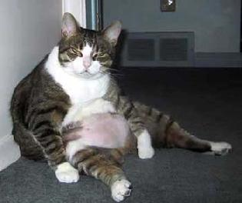

TISSUE PERFUSION
Definition – the relative amount of blood supply to an area or body system. It affects how rapidly drugs will be distributed.
  Drugs travel rapidly to well perfused tissues (brain). May initially have high levels of drug.
  Drugs travel slowly to poorly perfused tissues (fat). May inititially have low levels of drug.
  Can also be affected by blood flow rates that are altered via vasoconstriction or vasodilation
    Decreased rates decrease the amount and rate of the drug that’s delivered to the tissues.

Slide 23
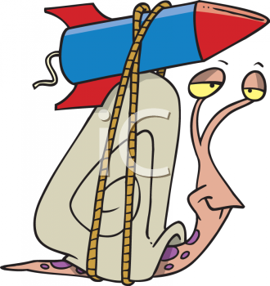
PROTEIN BINDING
Proteins are large in size and many drugs bind to them when they are in the body. This makes them too large to pass through capillary fenestrations and stuck in the circulatory system.
  INCREASED PROTEIN BINDING = less free drug available to the tissues
  DECREASED PROTEIN BINDING = more free drug available to the tissues.
Albumin is the main protein in circulation and is made in the LIVER. Animals with either liver disease or protein-losing enteropathies/nephropathies will have less protein in their body, thus more drug will be UNBOUND and available to the tissues. DECREASED dosages or different medications should be chosen as the patient may be exposed to high levels of the drug in it’s tissues. Also important because most drugs will be metabolized by the liver.

Slide 24
VOLUME OF DISTRIBUTION
How well a drug is distributed throughout the body based on the concentration of drug in the blood
Assumes that the drug concentration in the blood is equal to the drug concentration throughout the rest of the body
NOTE: will be lower if the drug has a large volume
to distribute itself through.
THE LARGER THE VOLUME OF DISTRIBUTION,
THE LOWER THE DRUG CONCENTRATION IN
THE BLOOD AND OTHER TISSUES AFTER DISTRIBUTION.
Less concentration may keep a drug out of therapeutic range and decrease its effectiveness. Dose may need to be increased in cases of larger volumes of distribution.

Slide 25
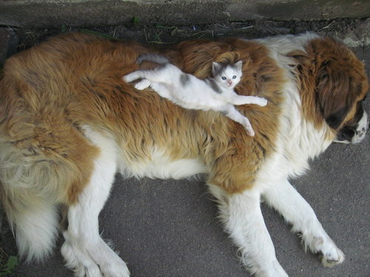
Volume of Distribution

